Slide 1

CARDIOVASCULAR STROKE ANALYSIS
THE POWER OF VISUAL ANALYTICS IN CLINICAL LABORATORY

Slide 2

What is heart failure?
It’s a condition that develops when your heart doesn’t pump enough blood for your body’s needs
The term ‘heart failure’ does not mean that your heart has stopped.
More than 6 million adults in the united states have heart failure.
Scope
To analyze and compare the results between the various attributes (in the data) of a person’s who are more likely or prone to Heart stroke

Slide 3

Importance of early prediction
Timely Intervention
Disease Progression Management
Reduced Treatment Costs
Prevention of Complications
Improved Quality of Life
Data-Driven Decision-Making
Psychological and Emotional Well-being

Slide 4

Overview of Heart Disease Data
Anaemia - Decrease of red blood cells or hemoglobin (boolean)
Age
Creatinine_phosphokinase - Level of the CPK enzyme in the blood (mcg/L)
Diabetes - If the patient has diabetes (boolean)
Ejection_fraction - Percentage of blood leaving the heart at each contraction (percentage)
High_blood_pressure - If the patient has hypertension (boolean)
Platelets - Platelets in the blood (kiloplatelets/mL)
Serum_creatinine - Level of serum creatinine in the blood (mg/dL)
Serum_sodium - Level of serum sodium in the blood (mEq/L)
Sex - Woman or man (binary)
Smoking Status
Death_Event

Slide 5

DATA VISUALIZATION
Data Visualization is the visual representation of data or information.
Typically, data is visualized in the form of a chart, diagram or map.
Tools:
Tableau
KNIME
Power BI
R
Python, etc.

Slide 6
Tools of the project
Tools Used
Tableau
KNIME

Slide 7
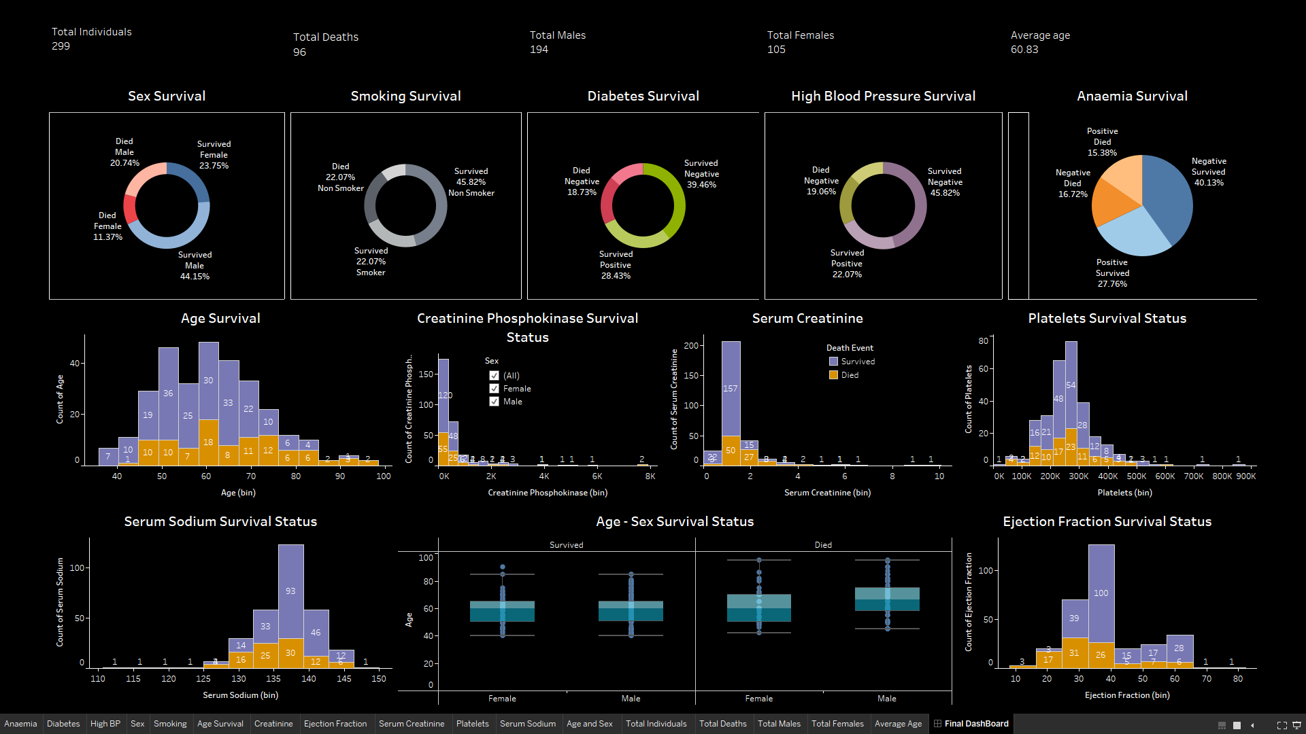

Slide 8
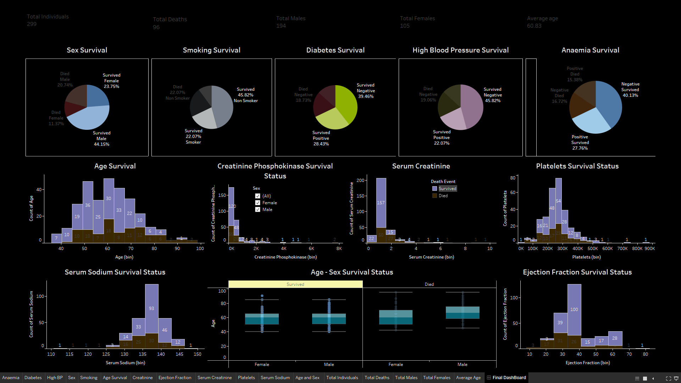

Slide 9
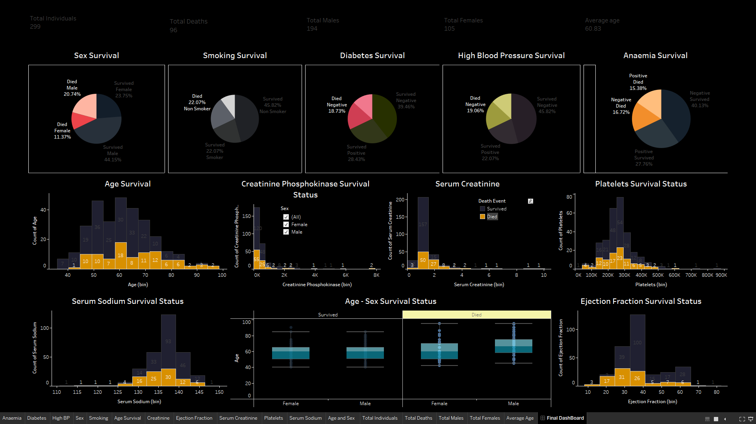

Slide 10
KNIME
KNIME = Konstanz Information Miner
KNIME (Konstanz Information Miner) is an open-source data analytics, reporting, and integration platform. It allows users to visually design data workflows, execute data analysis processes, and integrate various data sources and formats.
Notes:
KNIME is an open-source data analytics and integration platform with a graphical user interface that enables the assembly of data workflows using a wide range of data processing nodes.

Slide 11
Model Building in KNIME
Logistic Regression
Random Forest Variable
Notes:
This type of regression is used when the dependent variable is binary (e.g., yes/no, alive/dead). It models the probability of the dependent variable being one value or the other.
Random Forest is a machine learning algorithm that is used for classification and regression tasks. It is an ensemble method that combines multiple decision trees to make a more accurate and robust prediction.

Slide 12
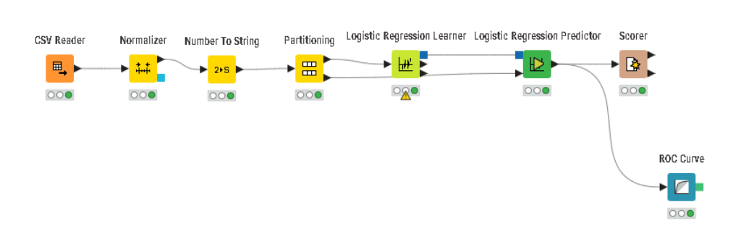
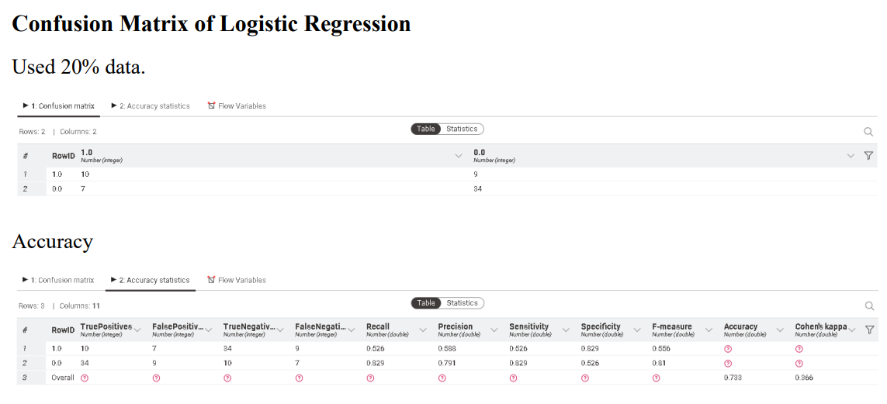
Logistic Regression
Notes:
When should we run logistic regression? When Dependent Variable – One, Independent Variable – Many
Dependent Variable – Categorical , Independent Variable – Continuous or Categorical.

Slide 13
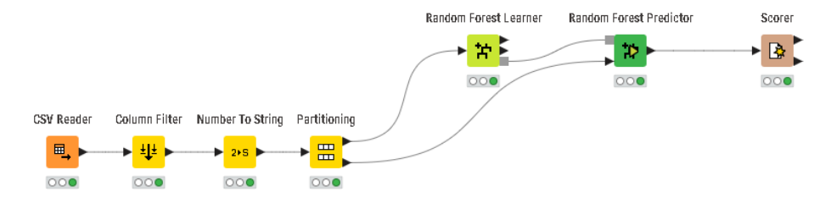
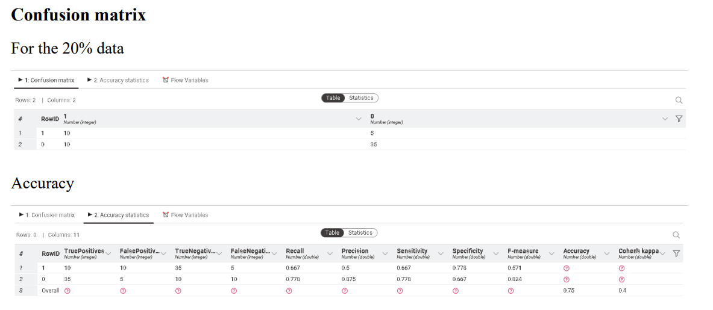
Random Forest Variable
Notes:
In a Random Forest, many decision trees are constructed on different subsets of the dataset. Each decision tree is constructed by randomly selecting a subset of features and a subset of data points from the original dataset.
More accurate than individual decision trees and Less prone to overfitting

Slide 14


Conclusion
Random Forest appears to be the best performing model based on accuracy.
Logistic Regression offers good accuracy and interpretability but might not perform as well on complex datasets.

Slide 15

Thank You. Hope we meet again.

